Slide 1
Payload Setup

Slide 2
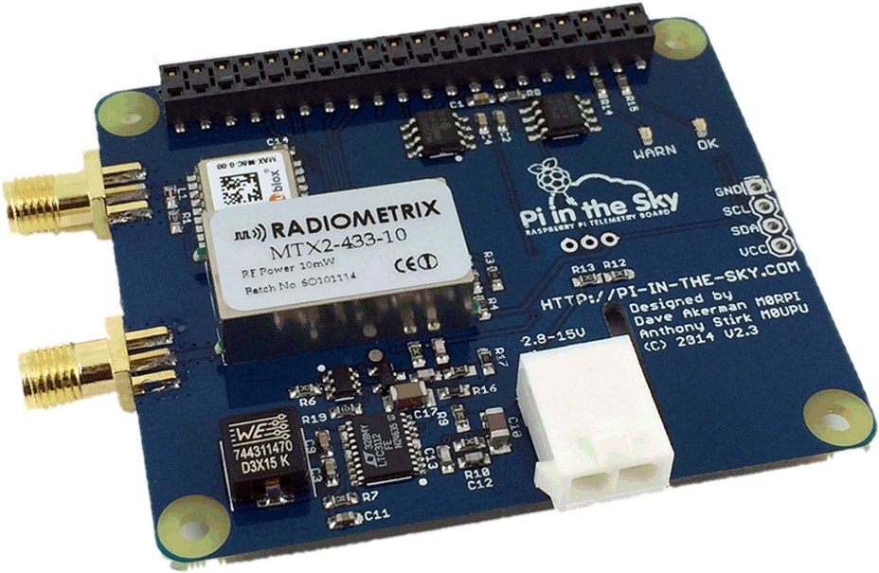
Pi In The Sky Telemetry Board

Slide 3

Session Aims
To understand the features of the the PITS telemetry board.
To assemble and configure the board.
To test basic functionality
You will need (per pair):
1 x payload kit
1 x SD card (yellow sticker)
1 x lapdock
1 x Y-cable
1 x HDMI cable

Slide 4
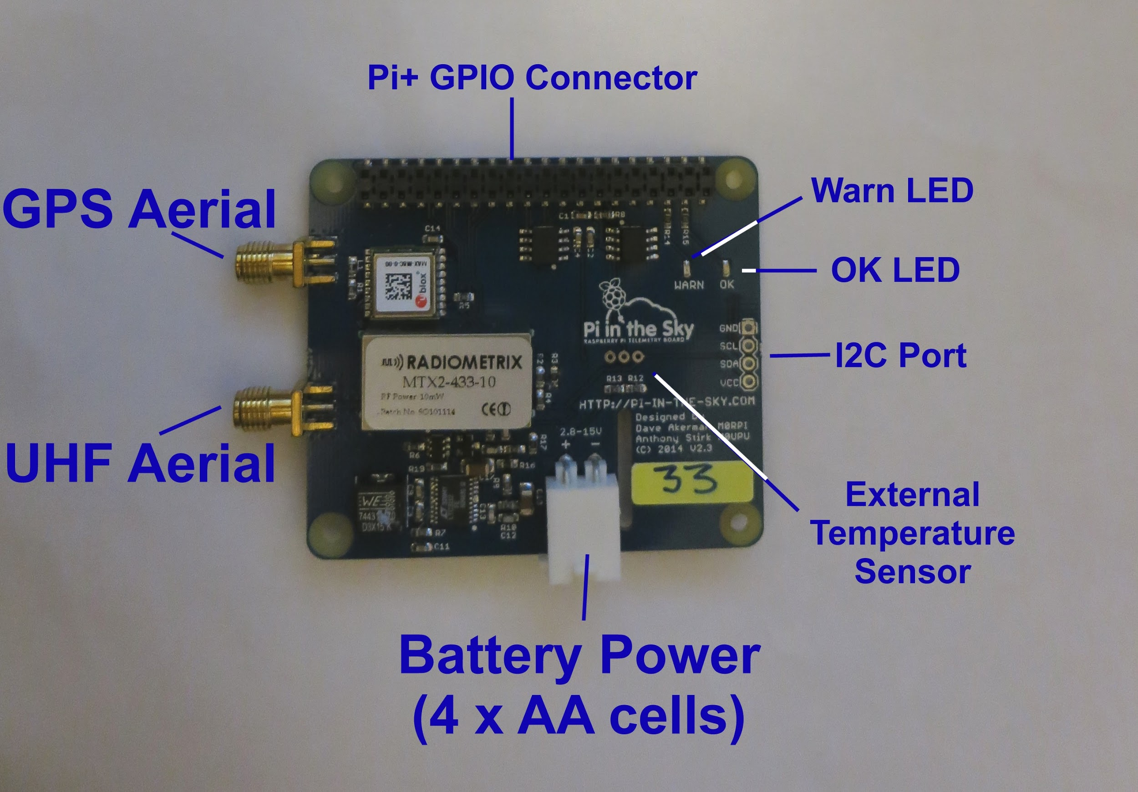

Slide 5
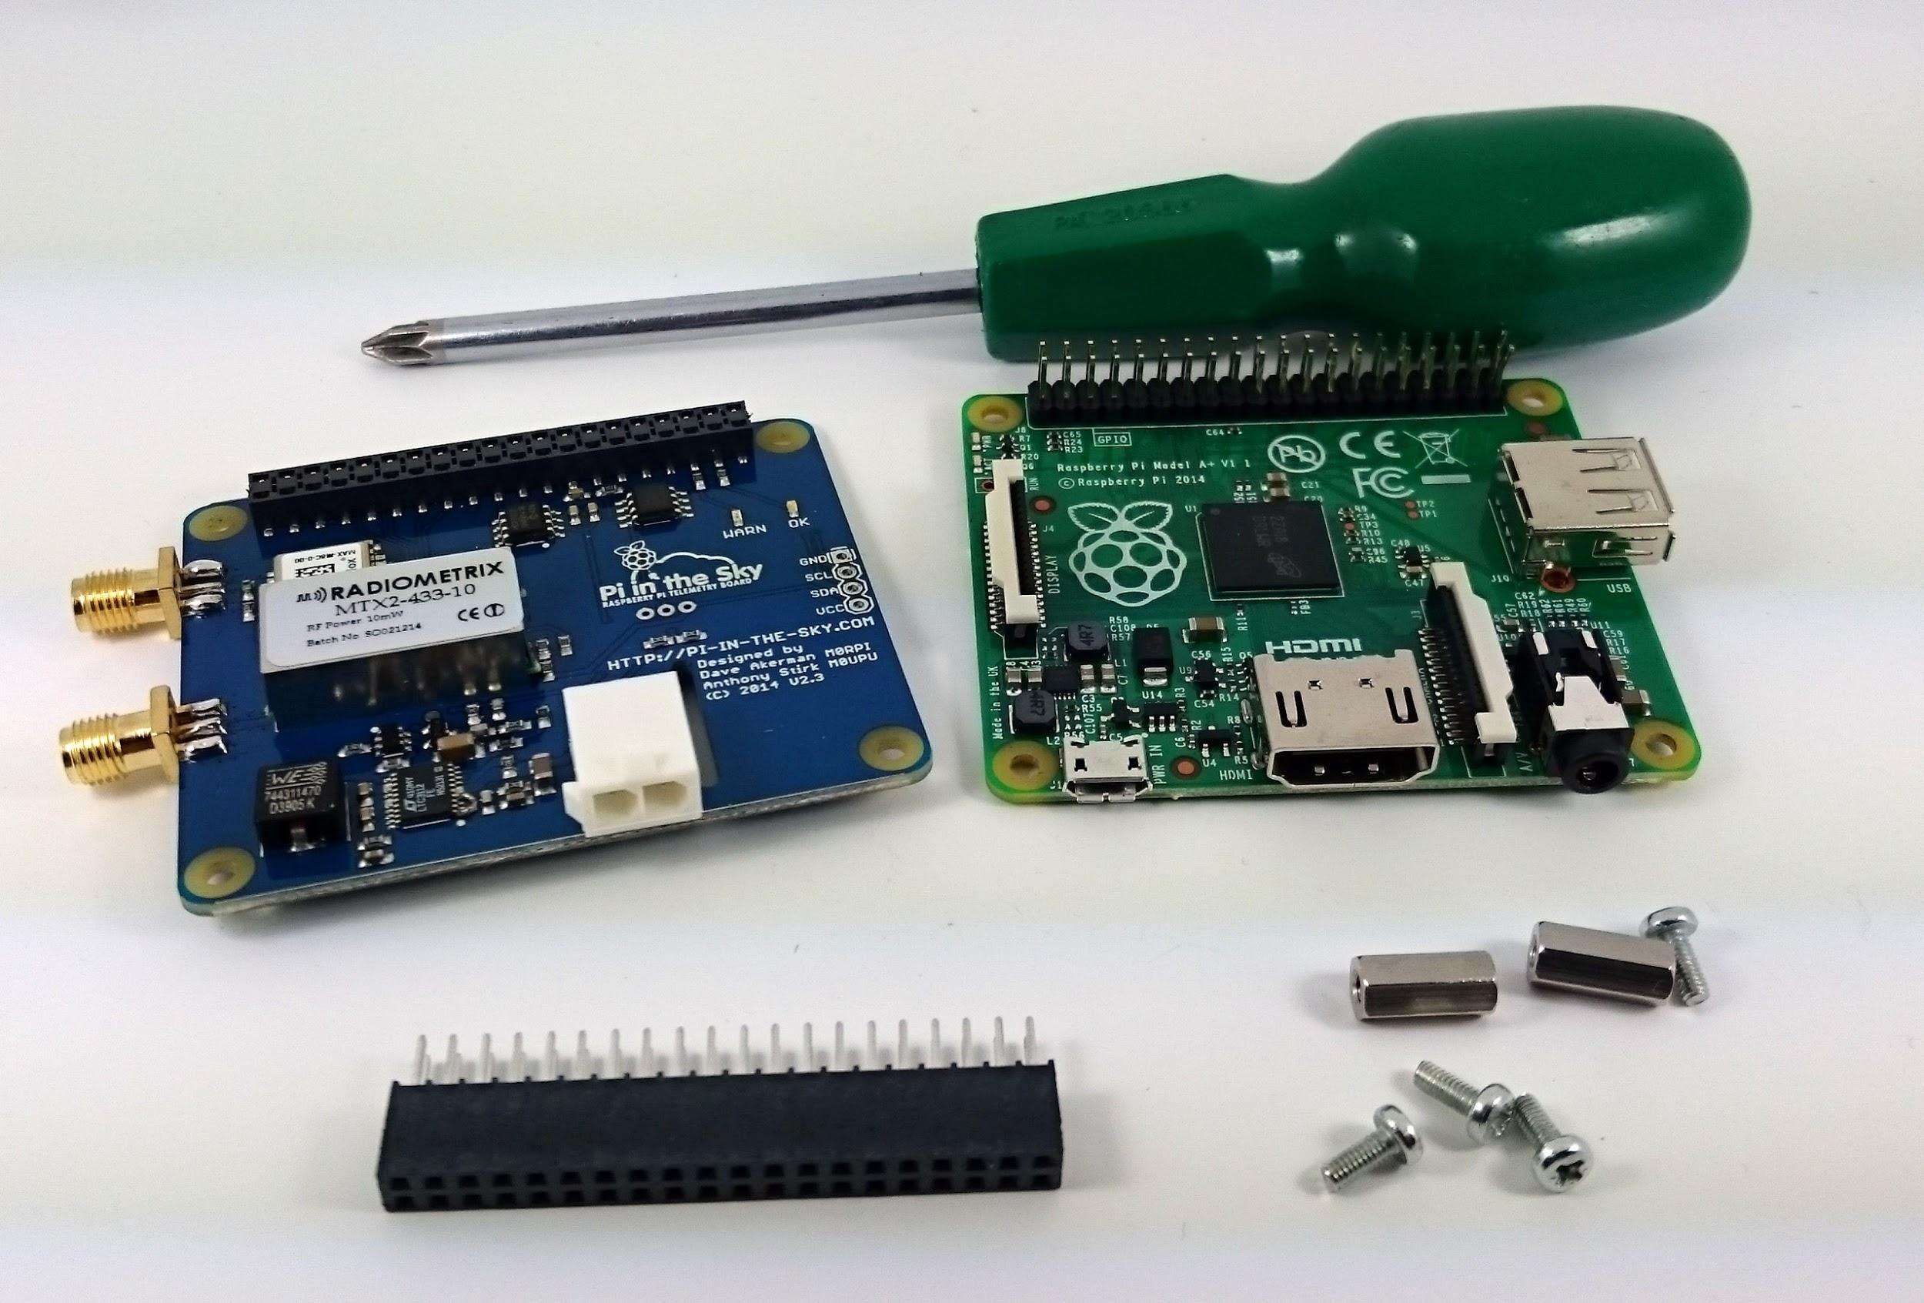
Assembly
Notes:
Build with B+ first for network and then assemble with A+ and camera at the end.

Slide 6
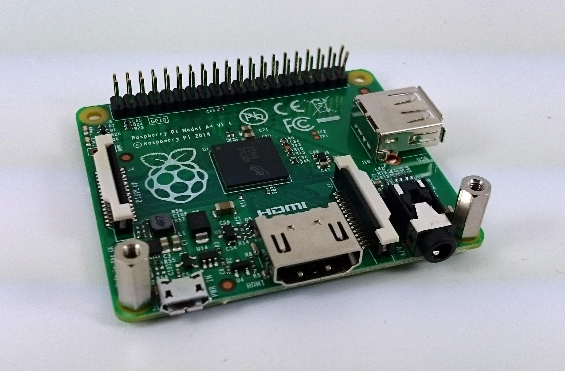
Add stand-offs

Slide 7
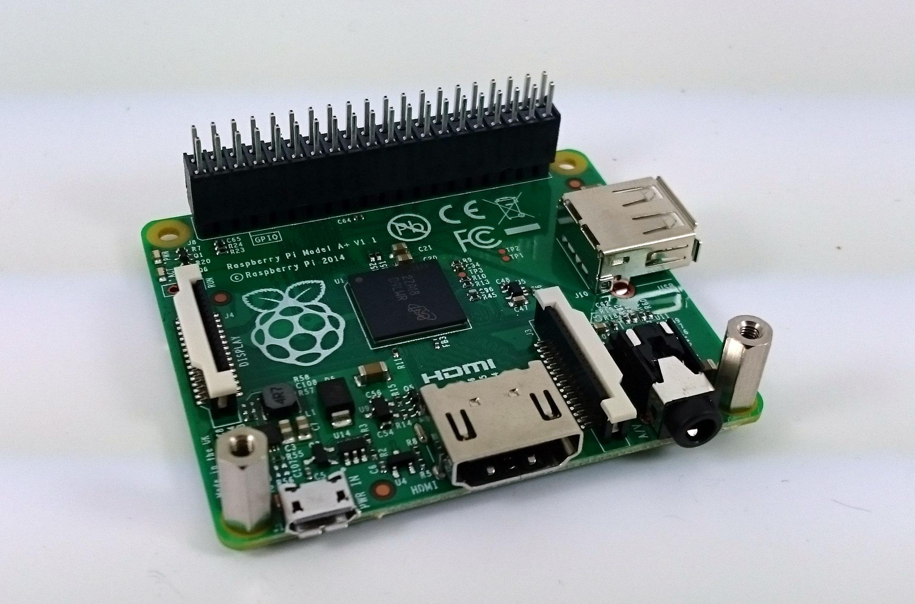
Add supplied header
Use extended header if stacking
Notes:
Assume we are stacking

Slide 8
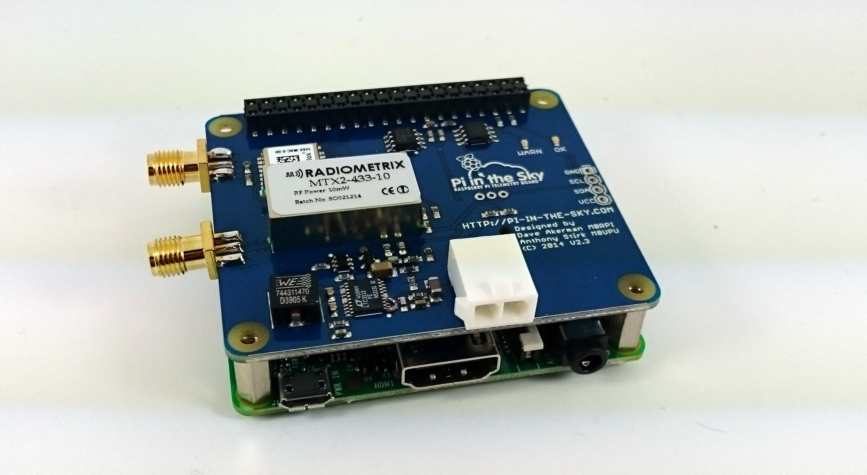
Push down PITS board

Slide 9
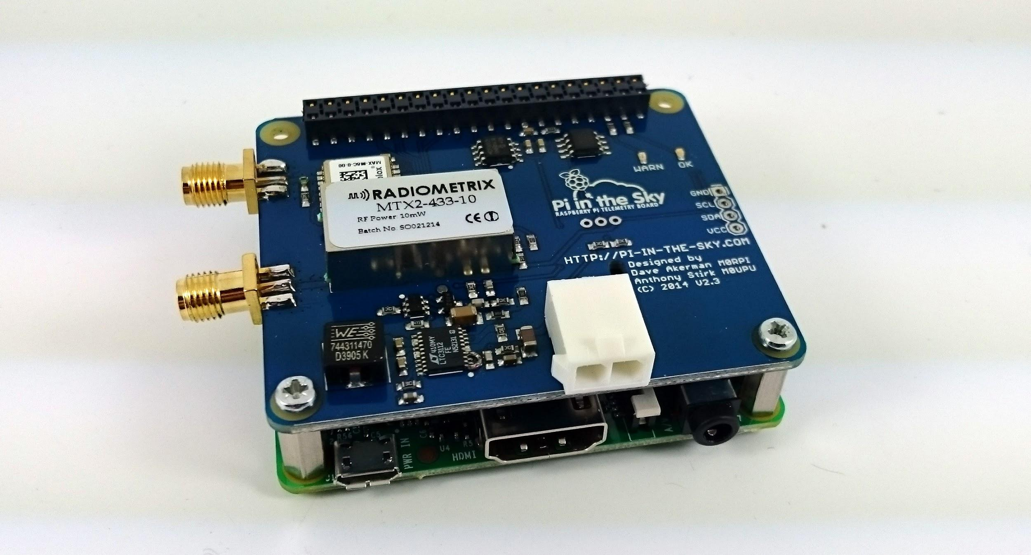
Fit screws
Notes:
At this stage demo how to connect to lapdock & ethernet

Slide 10
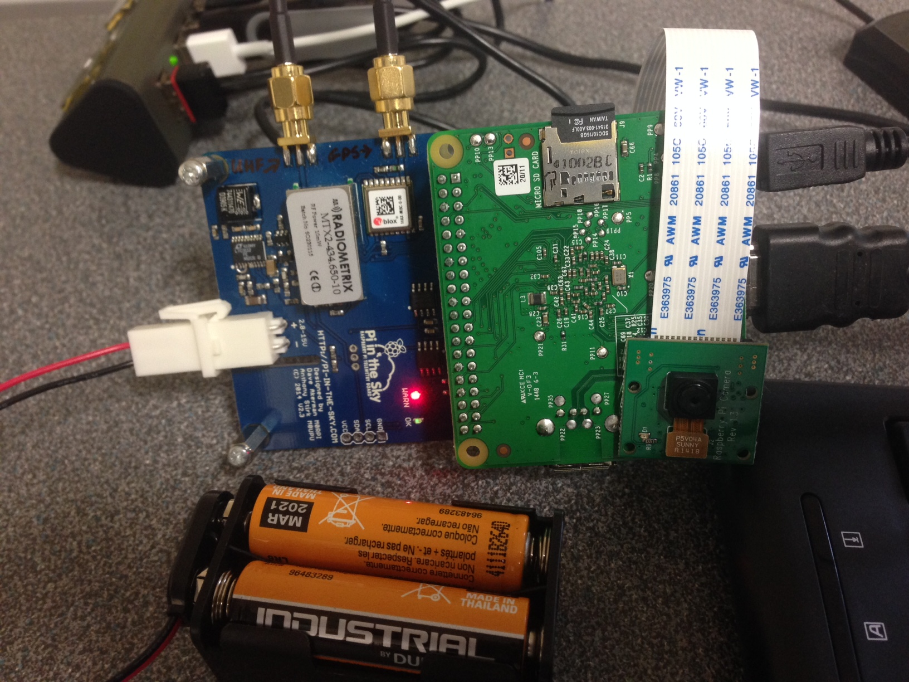
Please Don’t Do This ...

Slide 11
SD Card Build
Always begin with the most up to date Raspbian SD card you can find.
Login with username pi and password raspberry
Ensure your card is up to date using commands:
sudo apt-get update [enter]
sudo apt-get upgrade [enter]
Next enter the configuration menu by typing:
sudo raspi-config [enter]

Slide 12
SD Card Build
From raspi-config:
Expand Filesystem
Enable Camera → Enable
Advanced Options --> SPI → Yes → Ok → Yes → Ok
Advanced Options --> I2C → Yes → Ok → Yes → Ok (for optional sensors)
Advanced Options --> Serial → No → Ok
Advanced Options → Device Tree → No → Ok
Select Finish → Yes
A reboot may be required

Slide 13
Wiring Pi
type cp -R .skycademy_downloads/* .
The wiring pi software enables the Raspberry Pi to communicate with the PITS board, to install type:
cd wiringPi
./build

Slide 14
SSDV
The SSDV software enables the pits board to encode images to be transmitted over radio waves
cd /home/pi
cd ssdv
sudo make install

Slide 15
PITS tracker software
The PITS software logs telemetry data from the GPS antenna and some sensors, captures images and transmits this all via a series of radio packets.
cd /home/pi
cd pits
./build
Test the tracker with this command:
./tracker/startup

Slide 16
Configuring the tracker (add camera)
First you need to edit the pisky configuration file:
sudo nano /boot/pisky.txt
payload=Changeme
disable_monitor=N
frequency=434.600
baud=300
Change the red settings to match those for your team.

Slide 17
Configuring the tracker (add camera)
camera=Y
low_width=320
low_height=240
high=2000
high_width=640
high_height=480
image_packets=4
…
…
full_low_width=640
full_low_height=480
full_high_width=2592
full_high_height=1944
full_image_period=60

Slide 18
Configuring the tracker (add LoRa)
LORA_Frequency_1=434.250
LORA_Payload_1=RPF-A2
LORA_Mode_1=1
#LORA_low_width_1=640
#LORA_low_height_1=480
#LORA_high_width_1=1280
#LORA_high_height_1=960
#LORA_image_period_1=30
LORA_image_packets_1=20

Slide 19
Now reassemble with A+ and camera and test
Notes:
At this stage demo how to connect to lapdock & ethernet

